Slide 1
Storage in the Cloud
Lecturer: Ngo Huy Bien
Software Engineering Department
Faculty of Information Technology
University of Science
Ho Chi Minh City, Vietnam
nhbien@fit.hcmus.edu.vn

Slide 2

Objectives
To install and configure a NAS OS.

Slide 3

Contents
Local Storage.
RAID.
Network-Attached Storage (NAS).
Storage Area Network (SAN).
Cloud Storage Services.

Slide 4

References

Slide 5
Local Storage
Disks, Direct-Attached Storage.
RAID (Redundant array of inexpensive/independent disks).
File Systems.
Btrfs (B-tree filesystem), XFS (Linux)
APFS (Apple File System)
ReFS (Resilient File System) (Windows Servers)

Slide 6


Slide 7
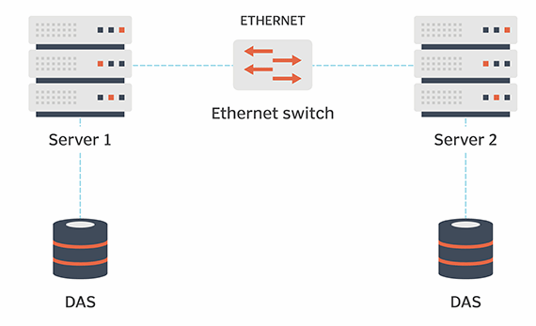
Direct-Attached Storage (DAS)
Direct-attached storage (DAS) is storage that's directly attached to a single computer.
It's not networked and so can't easily be accessed by other devices.
The most common example of DAS is a single computer’s hard drive.

Slide 8
RAID
Redundant array of inexpensive (sometimes “independent”) disks (RAID) is a fundamental and critical method of storing the same data several times.
RAID is used to increase data availability (by protecting against the failure of a drive) and to scale performance beyond that of a single drive.

Slide 9
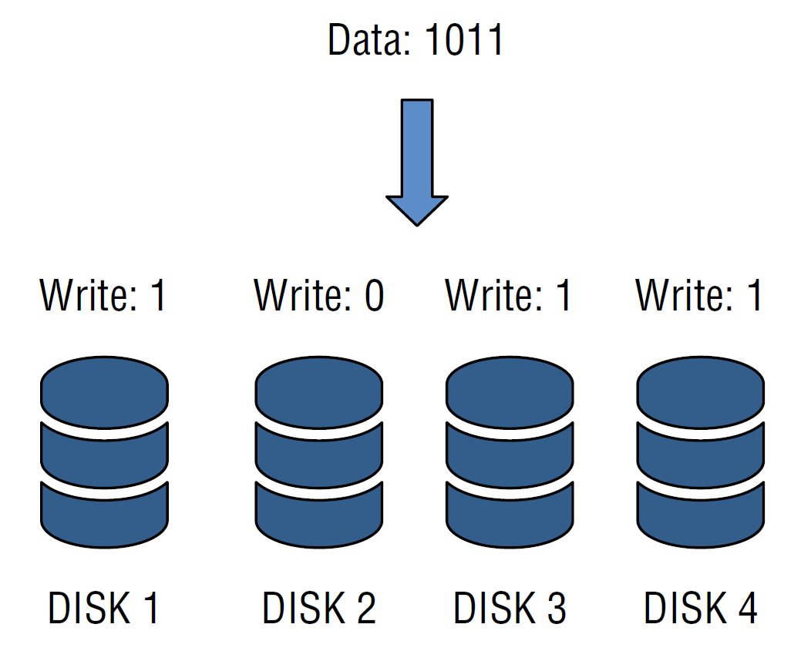
RAID 0
In a RAID 0 configuration, the data is striped across all the disks in the RAID set, providing very good performance but very poor availability.

Slide 10
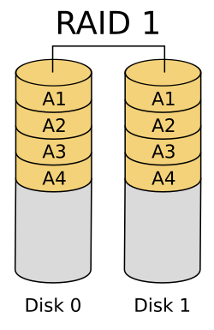
RAID 1
RAID 1 simply writes every I/O to two (or more) drives and can balance reads across all drives (because there are multiple copies).
To implement RAID 1, you need at least two physical hard drives. You also need a disk controller that supports RAID.

Slide 11
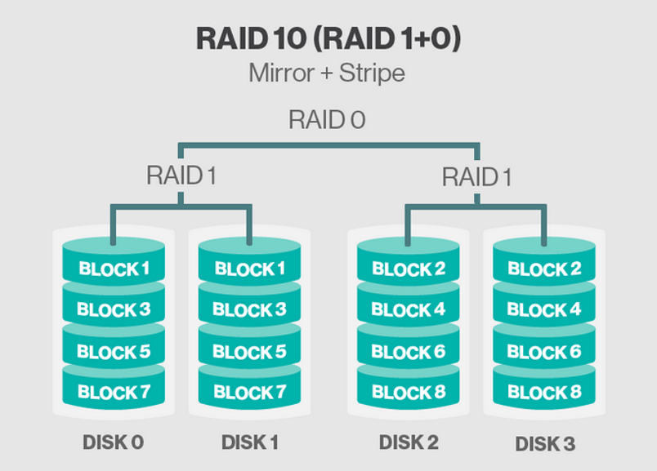
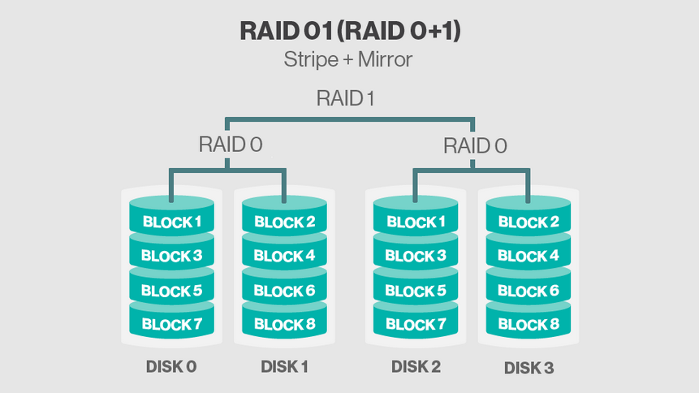
RAID 10 (1+0), RAID 01 (0+1)
RAID 10 = RAID 1+0 mirrors a stripe set.
RAID 01 = RAID 0+1 stripes data across pairs of mirrors.
RAID 10 achieves fast read and write speeds. Data is read and written in parallel across multiple disk pairs.
To implement RAID 10, you need at least four physical hard drives. You also need a disk controller that supports RAID.

Slide 12
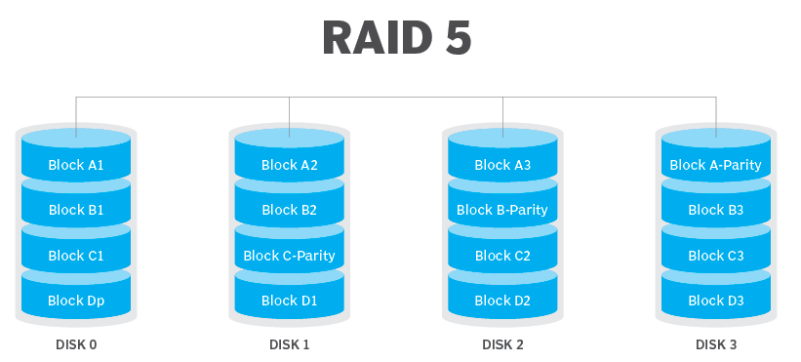
RAID 5 (Parity RAID)
RAID 5 uses a mathematical calculation (an XOR parity calculation) to represent the data across several drives.
This tends to be a good compromise between the availability of RAID 1 and the capacity efficiency of RAID 0.

Slide 13
RAID 5
RAID 5 calculates the parity across the drives in the set and writes the parity to another drive.
This parity block calculation with RAID 5 is rotated among the disks in the RAID 5 set.
When a drive fails in a RAID 5 set, I/O can be fulfilled using the remaining drives and the parity drive.
A RAID 5 array requires a minimum of three disks.
A RAID 5 4+1 configuration offers a balance between performance and efficiency.

Slide 14
XOR Parity Calculation
0 XOR 0 = 0 (Same inputs, output is 0.)
0 XOR 1 = 1 (Different inputs, output is 1.)
1 XOR 0 = 1 (Different inputs, output is 1.)
1 XOR 1 = 0 (Same inputs, output is 0.)
The parity bit is generated by applying the XOR operation successively to all the bits in the data.

Slide 15
Even Parity
In an even parity system, the goal is to make the total count of 1s (including the parity bit) an even number.
If the original data has an even number of 1s, the parity bit is 0.
If the original data has an odd number of 1s, the parity bit is 1 (to make the total count even).
For the data 1011:
1 XOR 0 = 1
1 XOR 1 = 0
0 XOR 1 = 1
The result is 1, so the parity bit is 1. The transmitted data would be 10111, which has four (even) 1s.

Slide 16
Odd Parity
In an odd parity system, the goal is to make the total count of 1s (including the parity bit) an odd number.
If the original data has an even number of 1s, the parity bit is 1.
If the original data has an odd number of 1s, the parity bit is 0.
For the data 1011:
1 XOR 0 = 1
1 XOR 1 = 0
0 XOR 1 = 1
The result is 1, so the parity bit is 0.
The transmitted data would be 10110, which has three (odd) 1s.

Slide 17
Example
Block | Bits
D1 | 0 1 1 1
D2 | 0 1 1 0
D3 | 1 1 1 1
D4 | 0 0 0 1
Parity for D1–D4
Compute XOR columnwise:
Bit 1: 0 ⊕ 0 ⊕ 1 ⊕ 0 = 1
Bit 2: 1 ⊕ 1 ⊕ 1 ⊕ 0 = 1
Bit 3: 1 ⊕ 1 ⊕ 1 ⊕ 0 = 1
Bit 4: 1 ⊕ 0 ⊕ 1 ⊕ 1 = 1
So parity block P = 1111.
RAID-5 rotates the parity across disks for each stripe. Because you have 4 data blocks, they fit in one stripe with 1 parity block on the fifth disk.

Slide 18
Variable-Length Blocks
RAID-5 does not accept variable-length blocks inside one stripe.
All strip units in a RAID-5 stripe must have equal size.
So to "write these 4 blocks," they must first be padded or segmented into equal-sized strip units.
Block | Original | Padded to 5 bits
B1 | 01111 | 01111
B2 | 01101 | 01101
B3 | 111 | 00111
B4 | 01 | 00001

Slide 19
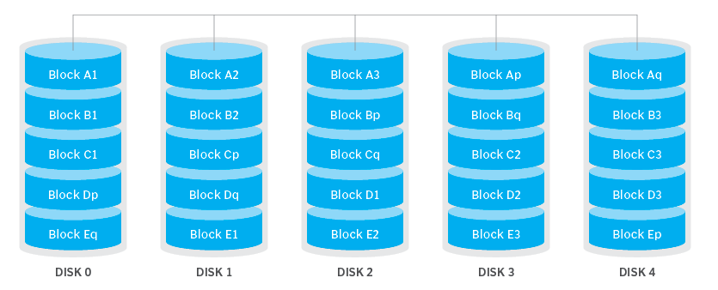
RAID 6

Slide 20
RAID 6 Parities
The P parity in RAID-6 is identical to RAID-5's XOR parity.
The Q parity is a Reed–Solomon code computed over a Galois field (GF(2⁸) in common implementations).
P and Q are not duplicates. They represent different linear combinations of the data blocks, allowing reconstruction when two blocks are missing.

Slide 21
Example P
D0 = 1011
D1 = 0110
D3 = 1101
D4 = 0001
P is the bitwise XOR of all data strips:
P = D0 ⊕ D1 ⊕ D2 ⊕ D3
Compute stepwise:
D0 ⊕ D1 = 1011 ⊕ 0110 = 1101
1101 ⊕ D2 = 1101 ⊕ 1101 = 0000
0000 ⊕ D3 = 0000 ⊕ 0001 = 0001
So P = 0001.

Slide 22
Example Q
EVENODD-style Q can be formed by XORing each data strip after rotating its bits left by the disk index (0..3).
With 4-bit symbols we use 4-bit left-rotates:
rotate_left(D0,0) = 1011
rotate_left(D1,1) = 0110 left-rotated 1 → 1100
rotate_left(D2,2) = 1101 left-rotated 2 → 0111
rotate_left(D3,3) = 0001 left-rotated 3 → 1000
Now XOR those rotated values:
1011 ⊕ 1100 = 0111
0111 ⊕ 0111 = 0000
0000 ⊕ 1000 = 1000
So Q = 1000.

Slide 23
D1 and D2 are lost
D0 = 1011
D1 = 0110 (lost)
D2 = 1101 (lost)
D3 = 0001
From earlier we had P = 0001, Q = 1000.
P=D0⊕D1⊕D2⊕D3
Q=rot(D0,0)⊕rot(D1,1)⊕rot(D2,2)⊕rot(D3,3)
These two linear equations uniquely solve for D1 and D2.

Slide 24
Notes
EVENODD is one of several RAID-6 constructions; others (Reed–Solomon, RDP, Blaum–Bruck–Huang, etc.) use different math (GF(2^m)) but the idea is the same: produce two linearly independent parity equations so two unknowns can be solved.

Slide 26
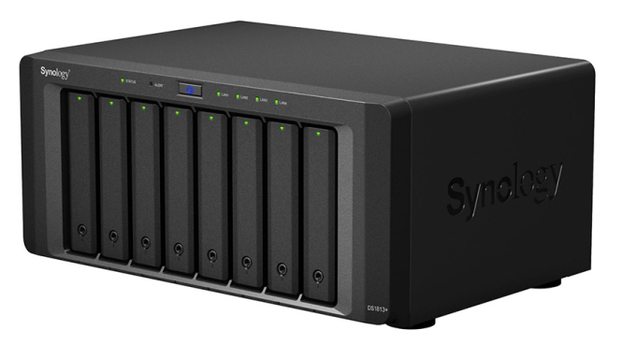
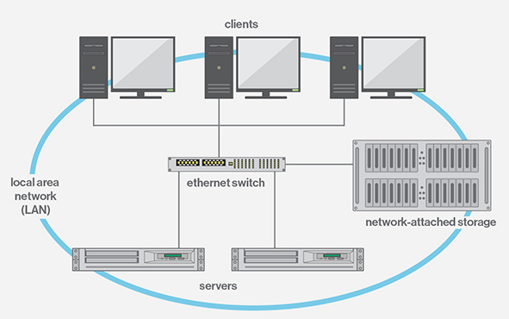
Network-Attached Storage (NAS)
A NAS box is formatted with data transfer protocols, which are standard ways of sending data between devices.
The files transferred across the protocols can be formatted as: Network File Systems (NFS), Server Message Blocks (SMB), Apple Filing Protocol (AFP).
These protocols can be accessed by clients through a switch, which is a central server that connects to everything and routes requests.

Slide 27
TrueNAS
TrueNAS (CORE or SCALE) is often called a NAS, but it can provide both file and block storage:
File-level: NFS, SMB, AFP shares.
Block-level: iSCSI targets that present raw LUNs (Logical Unit Numbers) over the network.

Slide 29
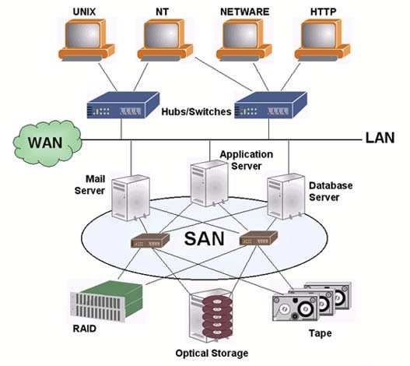
Storage Area Network (SAN)
A SAN is essentially a network that is intended to connect servers with storage.
The goal of any SAN is to take storage out of individual servers and locate the storage collectively where storage resources can be centrally managed and protected.

Slide 30
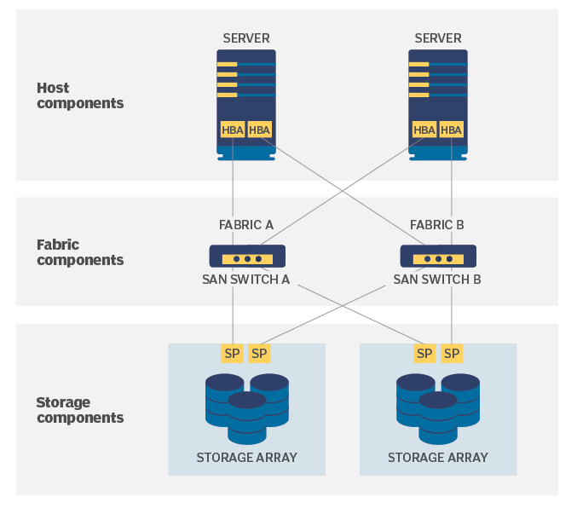
SAN Layers
A SAN is generally perceived as a series of three distinct layers: a host layer, a fabric layer and a storage layer.
Host layer. The host layer represents the servers that are attached to the SAN. In most cases, the hosts -- servers -- are running enterprise workloads, such as databases, that require access to storage.
Fabric layer. The fabric layer represents the cabling and network devices that comprise the network fabric that interconnects the SAN hosts and SAN storage.
Storage layer. The storage layer is comprised of the various storage devices collected into various storage pools, tiers or types. Storage typically involves traditional magnetic HDDs but can also include SSDs along with optical media devices, such as CD and DVD drives, and tape drives.

Slide 31
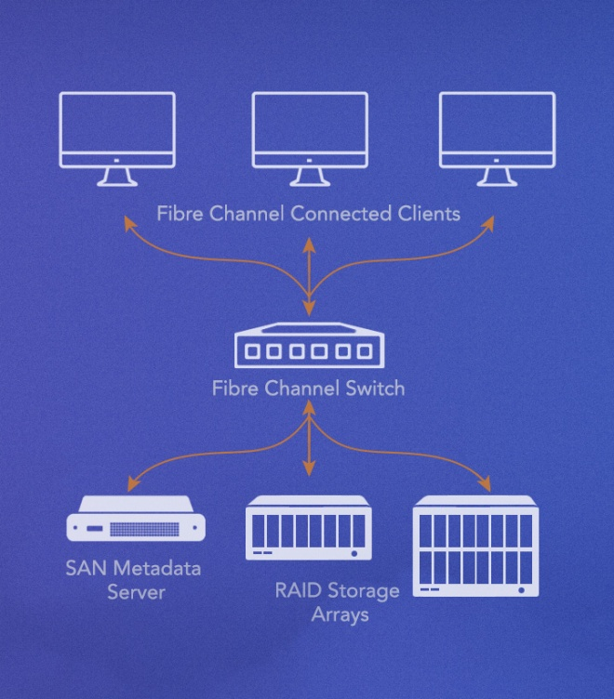
Fibre Channel
FC is a high-speed network noted for its high throughput and low latency, offering data rates up to 128 Gbps across metropolitan area distances -- up to about 6 miles or 10 km -- when optical fiber cabling and interfaces are used.
FC is implemented by deploying FC host bus adapters (HBAs) in each server, storage or FC network switches or other network devices.

Slide 32
SAN Architecture
The SAN switch receives a data packet, determines the source and destination of the packet and then forwards that packet to the intended destination device.

Slide 33
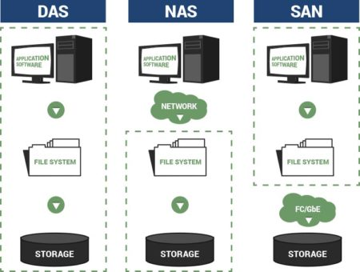
DAS vs. NAS vs. SAN
Block storage splits storage volumes—like hard disks, virtual storage nodes, or pools of cloud storage—into smaller volumes known as blocks, each of which can be formatted with different protocols.
For example, 1 block can be formatted for NFS, another can be formatted for AFP, and a third can be formatted for SMB. This gives users more flexibility, but also makes navigating the blocks harder since they're bundles data together using arbitrary classifications.

Slide 35
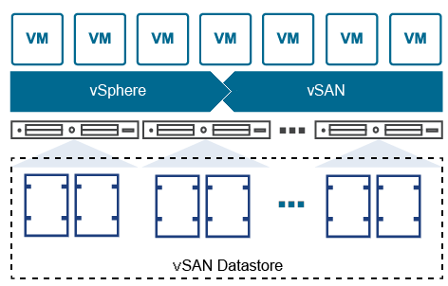
VMware vSAN
https://docs.vmware.com/en/VMware-vSAN/index.html
VMware vSAN is a software-defined, enterprise storage solution.
vSAN aggregates local or direct-attached data storage devices to create a single storage pool shared across all hosts in a vSAN cluster.
vSAN eliminates the need for external shared storage.

Slide 37
Cloud Storage Services
Block storage services.
File storage services.
Object storage services.
Relational database services.
NoSQL storage services.
Vector storage services.

Slide 38
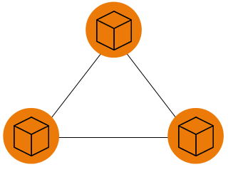
Block Storage Services
Volumes/Virtual disks
Provided by local machine or NAS or cloud.
Formatted for creating a filesystem (ext4, NTFS, ZFS) on top of those blocks to organize files.

Slide 39
Example: Amazon Elastic Block Store (EBS)
https://aws.amazon.com/ebs/
Easy to use, high performance block storage at any scale.
https://docs.aws.amazon.com/AWSEC2/latest/UserGuide/volume_constraints.html
Amazon EBS abstracts the massively distributed storage of a data center into virtual hard disk drives.
Partitioning scheme | Max addressable blocks | Theoretical max size (blocks × block size) | Ext4 implemented max size | XFS implemented max size | NTFS implemented max size | Max supported by EBS
MBR | 2³² | 2 TiB | 2 TiB | 2 TiB | 2 TiB | 2 TiB
GPT | 2⁶⁴ | 64 ZiB | 1 EiB = 1024² TiB (50 TiB certified on RHEL7) | 500 TiB (certified on RHEL7) | 256 TiB | 64 TiB

Slide 40
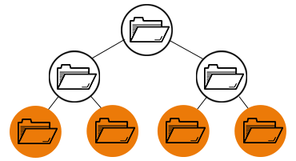
File Storage Services
Files and Folders.
Provided by local machine or NAS or cloud.
Ready for use.

Slide 41
Example: Amazon Elastic File System
https://aws.amazon.com/efs/
Serverless, fully elastic file storage.
https://docs.aws.amazon.com/efs/latest/ug/limits.html
Maximum name length: 255 bytes.
Maximum size of a single file: 52,673,613,135,872 bytes (47.9 TiB).
Maximum directory depth: 1,000 levels deep.
Any one particular file can have up to 512 locks across all instances connected and users accessing the file.

Slide 42
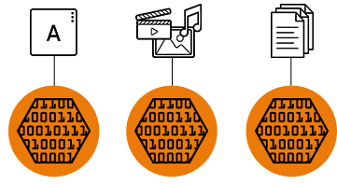
Object Storage Services
Object storage, also known as object-based storage, is a flat structure in which files are broken into pieces and spread out among hardware.
Object storage volumes work as modular units: each is a self-contained repository that owns the data, a unique identifier that allows the object to be found over a distributed system, and the metadata that describes the data.
Object storage requires a simple HTTP application programming interface (API), which is used by most clients in all languages.
Objects can’t be modified—you have to write the object completely at once.
Object storage also doesn’t work well with traditional databases, because writing objects is a slow process and writing an app to use an object storage API isn’t as simple as using file storage.

Slide 43
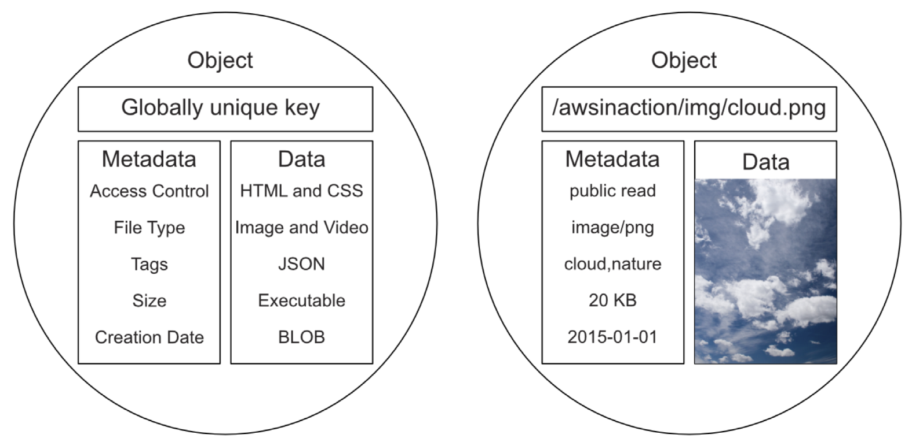
Object Elements
In an object storage, data is stored as objects.
Each object consists of a globally unique identifier, some metadata, and the data itself.

Slide 44
Example 1: Amazon Simple Storage Service
https://aws.amazon.com/s3/
Amazon Simple Storage Service (Amazon S3) is an object storage service offering industry-leading scalability, data availability, security, and performance.

Slide 45
Example 2: Swift
https://docs.openstack.org/swift/latest/
Swift is a highly available, distributed, eventually consistent object/blob store.
Organizations can use Swift to store lots of data efficiently, safely, and cheaply.

Slide 46
Example 3: RIAK S2
https://riak.com/products/riak-s2/
Riak S2 is a highly available, scalable, easy-to-operate object storage software solution that’s optimized for holding videos, images, and other files.
It provides simple but powerful storage for large objects built for private, public, and hybrid clouds.

Slide 47
Relational database services
https://aws.amazon.com/rds/
Set up, operate, and scale a relational database in the cloud with just a few clicks.
https://www.snowflake.com/en/
Turn enterprise data into instant insights with Snowflake Intelligence.

Slide 49

Further Reading
Davtd A Patterson et al. (1988). A Case for Redundant Arrays of Inexpensive Disks (RAID).
Peter M. Chen et al. (1994). RAID - High-Performance, Reliable Secondary Storage.

Slide 50

Thank You & See You Again

